Slide 1
Advanced Research Institute in Geriatric Mental Health
Webinar October 31, 2017
NIMH Update
George Niederehe, PhD
Jovier D. Evans, PhD
NIMH, Division of Translational Research
Geriatrics and Aging Processes Research Branch

Slide 2
AGENDA
Policy and Procedural Changes in NIH Handling of Clinical Trial Applications
Changes regarding R21 Applications
Required Application Components (e.g., Data Sharing Plan, Rigor & Reproducibility, Sex as a Biological Variable)
Changes for Career Development Awards
Questions
(time allowing) NIMH Research Priorities

Slide 3

Experimental Therapeutics Approach
to Interventions
Intervention as tool to validate or engage the target
Target Engagement informs “go/no-go” decision
Clinical Trial value optimized regardless of clinical effect
Notes:
NIMH requires an experimental therapeutics approach to the development and testing of interventions, in which interventions serve not only as potential treatments, but as proves to generate information about the mechanisms underlying a disorder:
Involves careful selection of treatment groups to test mechanisms
Early stage trials provide signs of failure or success
Negative results suggests attention should be redirected
“Doses” are based on adequacy of target engagement

Slide 4
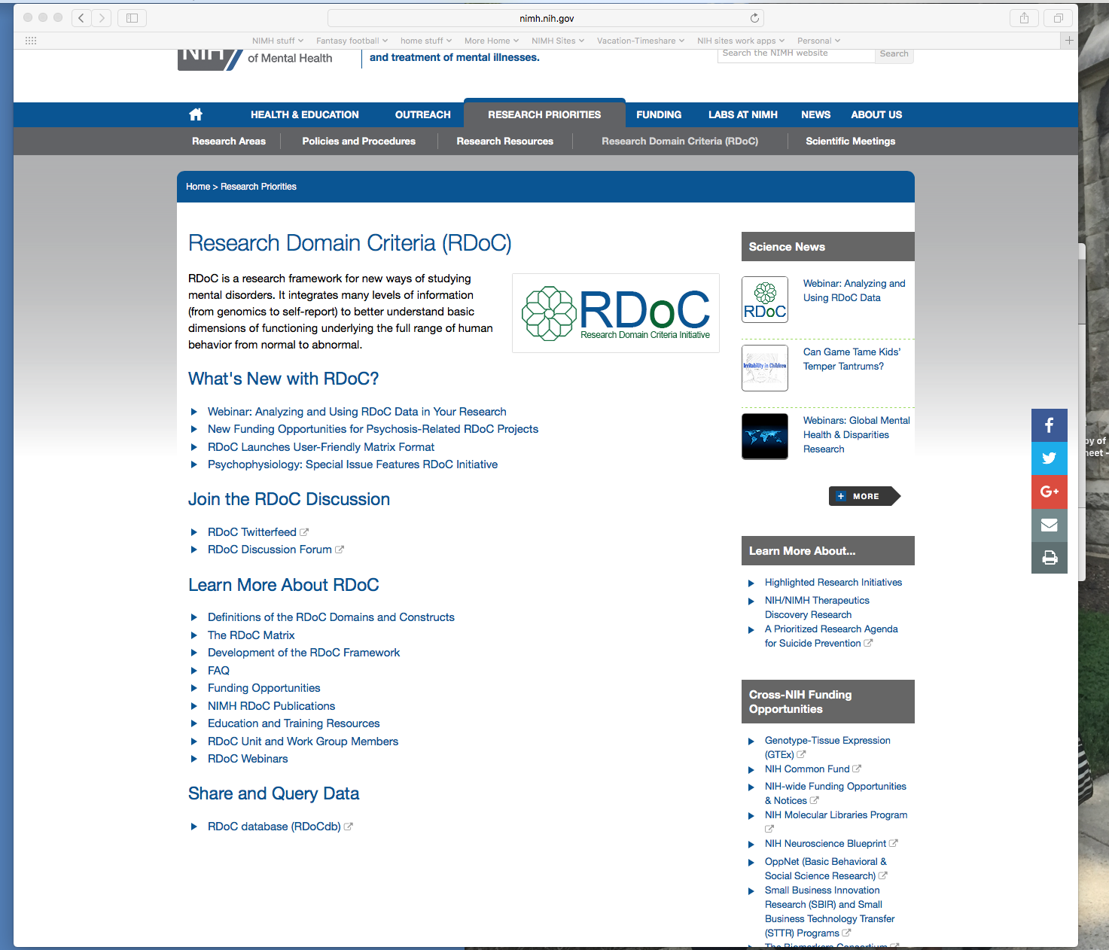

Slide 5
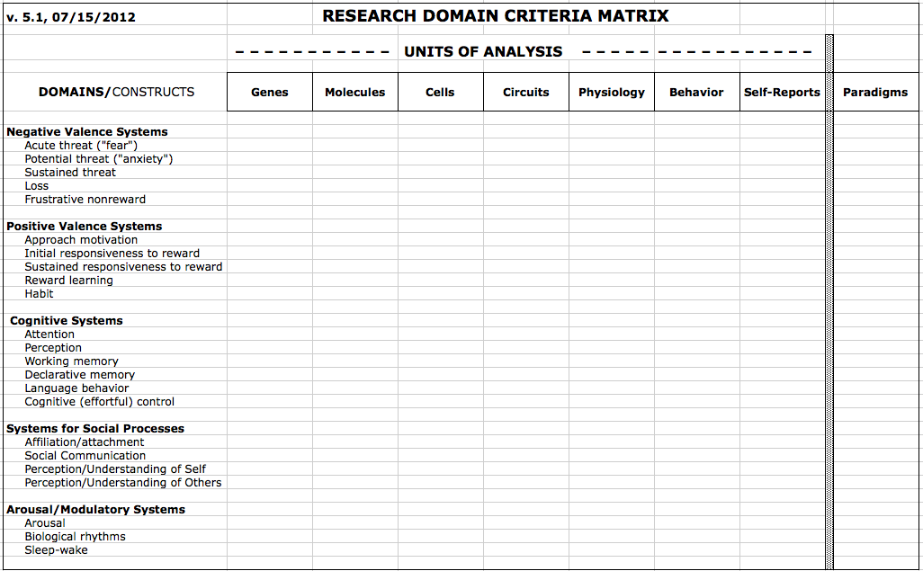
RDoC matrix: (v. 5.1)
Main points: An alternative approach to considering “disorder”:
Circuit/behavior based mechanisms, not DSM categories;
Consider dysregulated mechanisms in dimensional terms

Slide 6
RDoC domains and constructs
Cognitive Systems
Attention
Perception
Declarative memory
Language behavior
Cognitive (effortful) control
Working memory
Negative Valence Systems
Acute threat (“fear”)
Potential threat (“anxiety”)
Sustained threat
Loss
Frustrative non-reward
Positive Valence Systems
Approach motivation
Initial responsiveness to reward
Sustained responsiveness to reward
Reward learning
Habit
Arousal and Regulatory Systems
Arousal
Circadian rhythms
Sleep and wakefulness
Systems for Social Processes
Affiliation and attachment
Social communication
Perception and understanding of self
Perception and Understanding of Others
Notes:
At the heart of RDoC is a set of 5 domains, each with a subset of constructs
The domains and constructs don’t exactly roll off the tongue; that’s intentional, to get away from terminology that already has “baggage” and association with current diagnoses.
There is no one-to-one correspondence between a construct and a diagnosis.
These constructs were selected and defined at a series of workshops that included clinical and basic researchers.
-----------------------------------------------------
((Constructs are defined as: non-computable concepts based on convergent sets of data, AKA, a nomological net))

Slide 7

RDoC framework
Environment
Units of Analysis
Domains
Neurodevelopment

Slide 8

Doing Human Subjects Research?
Changing NIH Policies May Impact You

Slide 9
Study Publication, Data Sharing, and Data Harmonization: Background Factors
Concerns about the reproducibility of NIH-funded basic research; calls for greater methodological rigor
Rates of failure to register trials in CT.gov
Rates of failure to publish NIH-supported trials (e.g., NEJM article on compliance with results reporting, March 2015); concerns about publication bias in the cumulative evidence base
Precedents: perception of positive benefits flowing from NIH regulations on sharing of genomic data

Slide 10
Actions Regarding Results Publication
New NIH definition of Clinical Trials (Oct. 2014)
HHS Notice of Proposed Rule Making (regarding registration of trials with ClinicalTrials.gov, and reporting of additional data elements -- Nov. 2014)
Companion NIH Guide notice proposing the same requirements for ALL NIH-funded clinical trials, not just ACTs (Nov. 2014); NEJM article (Jan. 2015)
Period for public comment (Nov. 2014 – March 2015)
IOM report on Strategies for Responsible Sharing of Clinical Trials Data (Jan. 2015)

Slide 11
NIH Initiatives to Enhance Clinical Trial Stewardship
Clinical Trial FOAs
Good Clinical Practice
Registration & Reporting
Enhancing Clinical Trial
Stewardship at NIH
Single IRB
New Application Forms
Accountability
Transparency
Efficiency
Dissemination
Clinical Trial Review Criteria
Learn more at https://grants.nih.gov/policy/clinical-trials.htm

Slide 12
NIH Definition of Clinical Research
Research with human subjects that is:
1) Patient-oriented research. Research conducted with human subjects (or on material of human origin such as tissues, specimens, and cognitive phenomena) for which an investigator (or colleague) directly interacts with human subjects.
  Excluded: in vitro studies that utilize human tissues that cannot be linked to a living individual.
  Included: (a) mechanisms of human disease, (b), therapeutic interventions, (c) clinical trials, or (d) development of new technologies.
2) Epidemiological and behavioral studies.
3) Outcomes research and health services research

Slide 13
NIH Definition of Clinical Trial
A research study in which one or more human subjects are prospectively assigned to one or more interventions (which may include placebo or other control) to evaluate the effects of those interventions on health-related biomedical or behavioral outcomes.
“Prospectively assigned" refers to a pre-defined process (e.g., randomization) specified in an approved protocol that stipulates the assignment of research subjects (individually or in clusters) to one or more arms (e.g., intervention, placebo or other control) of the clinical trial.
An intervention is defined as a manipulation of the subject or subject's environment for the purpose of modifying one or more health-related processes and/or endpoints. Examples: drugs, devices; procedures; delivery systems (e.g., telemedicine, face-to-face); strategies to change health-related behavior; treatment, prevention, and diagnostic strategies.
A health-related biomedical or behavioral outcome is defined as the pre-specified effect of an intervention on the study subjects. Examples: positive or negative changes to physiological or biological parameters; psychological or neurodevelopmental parameters; disease processes; health-related behavior; well-being or quality of life

Slide 14
Reforms & Initiatives
To enhance the stewardship of research involving human subjects, NIH is implementing the following:
All Research Involving Human Participants
Research that Meets the NIH Definition of a Clinical Trial
New forms to collect human subjects information
Use of a single Institutional Review Board (IRB) for multi-site studies
Certificates of confidentiality for all research that uses “identifiable, sensitive information”
Training in Good Clinical Practice (GCP)
Clinical trial-specific Funding Opportunity Announcements (FOAs)
New review criteria
Expanded registration and results reporting in ClinicalTrials.gov

Slide 15
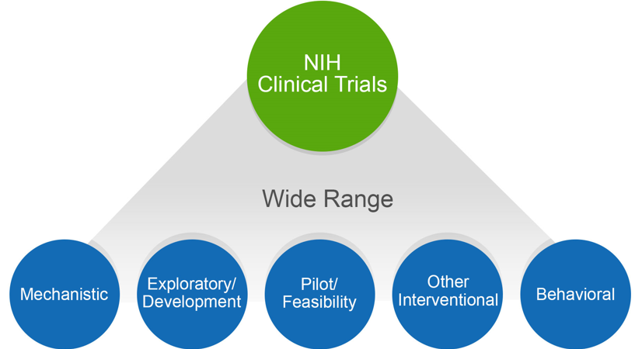
NIH Might Consider Your Human Subjects Research to be a Clinical Trial
Does your study…
Involve one or more human subjects?
Prospectively assign human subject(s) to intervention(s)?
Evaluate the effect of intervention(s) on the human subject(s)?
Have a health-related biomedical or behavioral outcome?
If “yes” to ALL of these questions, your study is considered a clinical trial
Unsure how to answer the questions? We have a tool that can help! https://grants.nih.gov/ct-decision/

Slide 16
Identifying Whether NIH Considers Your
Study to be a Clinical Trial is Crucial
It impacts whether you need to:
    Respond to a clinical trial-specific FOA
    Address additional review criteria specific for clinical trials
    Register and report your clinical trial in ClinicalTrials.gov

Slide 17
Identifying the Right Funding Opportunity Announcement (FOA) is Key
Due Dates on or after January 25, 2018
  All clinical trial applications MUST be submitted to an FOA that allows clinical trials
How to determine if an FOA accepts clinical trials?
Refer to Section II. Award Information
Indicated in FOA title (new FOAs only)
Tip: Check your FOA at least 30 days before the due date for any updates
Notes:
See policy notice for table that provides dates for reviewers eligible for continuous submission, late applications, etc.

Slide 18
2014 NIMH Policy on Clinical Trials Research
“Experimental Therapeutics” model adopted – applicable to all trials research
No longer accept clinical trials applications through the standard R01, R21 or R03 grant mechanisms (i.e., under their “parent” PAs); must apply under NIMH’s specific clinical trial FOAs
Same general principles and priorities apply across other grant mechanisms if there is a clinical trial component (e.g., K award projects, SBIR, AREA)
But….there are some exceptions (e.g., biomarker or “probe” studies, certain joint PAs with other institutes)

Slide 19
NIMH’s Current Funding Opportunity Announcements for Intervention Development Clinical Trials
Clinical Trial Pipeline - Phase of Intervention Development
First in Human | Exploratory Experimental Therapeutics | Confirmatory Efficacy | Effectiveness (Prevention, Treatment, Services)
First in Human and Early Stage Clinical Trials of Novel Investigational Drugs or Devices for Psychiatric Disorders (U01)* |  |  | Pilot Effectiveness Trials for Treatment, Preventive and Services Interventions (R34)
 | Early Stage Testing of Pharmacologic or Device-based Interventions for the Treatment of Mental Disorders (R61/R33) and (R33)* | Confirmatory Efficacy Clinical Trials of Non-Pharmacological Interventions for Mental Disorders (R01) | Clinical Trials to Test the Effectiveness of Treatment, Preventive, and Services Interventions (R01)
 | Development of Psychosocial Therapeutic and Preventive Interventions for Mental Disorders (R61/R33) and (R33) |  | Clinical Trials to Test the Effectiveness of Treatment, Preventive, and Services Interventions (Collaborative R01)
Notes:
Changes were made to all clinical trials FOAs in an effort to clarify NIMH’s interest in an experimental therapeutics approach to the development and testing of interventions across all modalities.
One major change is that there are now two separate “early stage” FOAs for the development of:
psychosocial interventions, and
drugs or direct brain modulation/stimulation devices.

Slide 20
Previously, Some “Exceptions” to the RFA Requirement for Clinical Trial Applications
Standard grant mechanisms (R01, R21, R03) were still allowed for submitting certain types of applications containing clinical trial components, e.g.,
  “Probe” studies -- a treatment used as experimental tool to understand pathophysiology of a disorder rather than to answer questions about the treatment
  “Biomarker” studies -- focused on developing predictors or moderators of treatment response in order to better personalize treatment
Key has been that such studies were not about intervention development; aims could not include efficacy questions; see FAQs on clinical trials web page

Slide 21
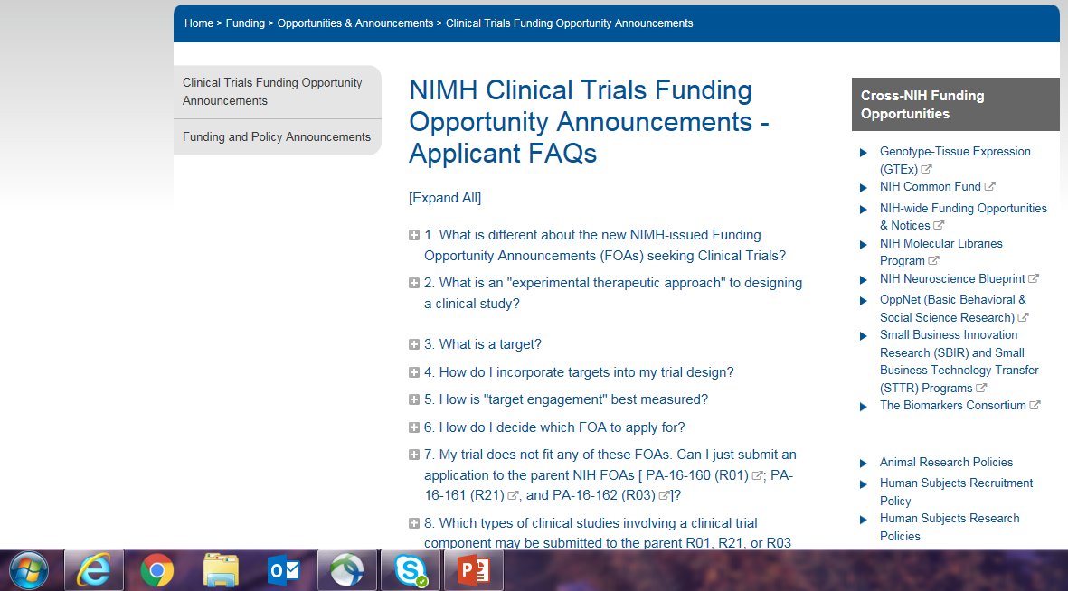

Slide 22
New Concept Expected: Mechanistic Clinical Trials
NIH defining a new subcategory of clinical trial, referred to as “mechanistic clinical trials”
Basic idea expected to be very similar to NIMH’s previous “Probe” and “Biomarker” studies
NIMH planning to join a general NIH Parent Announcement about mechanistic clinical trial applications, rather than issuing a NIMH-specific FOA
Will use standard R01s (and perhaps R21s?) that allow/require this type of clinical trial

Slide 23
Clinical Trial Specific Review Criteria
FOAs will include additional criteria:
Scored Review Criteria
  Significance
  Investigator
  Innovation
  Approach
  Environment
Additional Review Criteria
  Study Timeline & Milestones
Read the FOA carefully and be sure your application addresses the review criteria appropriately

Slide 24
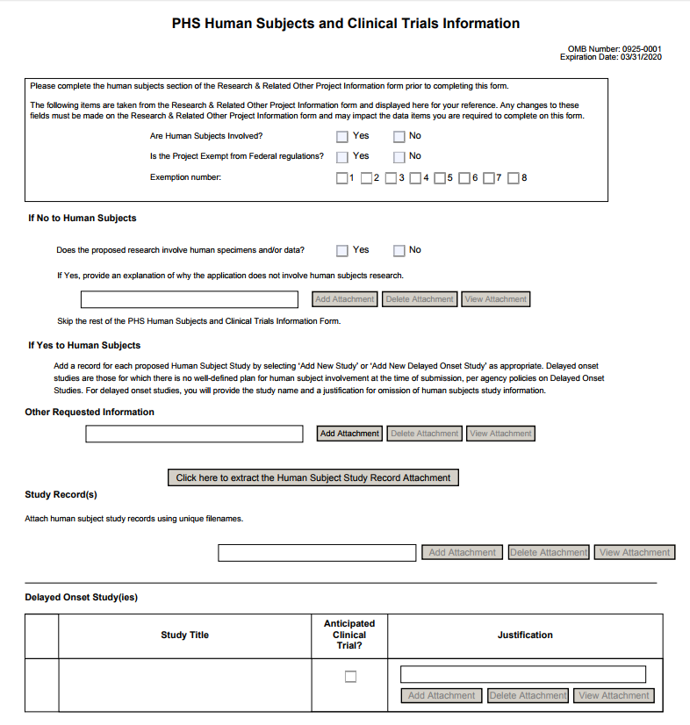
New Application Packages (FORMS-E)
Due Dates on or after January 25, 2018
  FORMS-E Application Packages is REQUIRED (including new Human Subjects and Clinical Trials form)
PHS Human Subjects and Clinical Trials Information Form
Consolidates information from multiple forms
Incorporates structured data fields
Collects information at the study-level
Be sure you are using the correct application forms for your due date.
FORMS-E will be available October 2017.
See https://grants.nih.gov/policy/clinical-trials/new-human-subject-clinical-trial-info-form.htm
Notes:
See table in guide notice NOT-OD-17-062 for timing for continuous submitters, late applications, etc. . More information on new form at https://grants.nih.gov/policy/clinical-trials/new-human-subject-clinical-trial-info-form.htm

Slide 25
Changes to the Appendix Policy
Due Dates on or after January 25, 2018
  Since the new Human Subjects and Clinical Trials Information form collects key elements from the protocol, the optional protocol submission will be removed from the Appendix Policy.
Parent FOAs
  Will NEVER allow inclusion of the protocol in the application
  If the protocol is included, the application will be sent back
IC issued FOAs
  Protocols and other materials allowed only when specified as required in the FOA
See NIH Guide Notice: https://grants.nih.gov/grants/guide/notice-files/NOT-OD-17-098.html

Slide 26
Registering & Reporting NIH-funded Clinical Trials in ClinicalTrials.gov
Who:
All clinical trial applications requesting support for a trial that will be initiated on/after January 18, 2017
Register and report the results of trials in ClinicalTrials.gov
Increase the availability of information about clinical trials and their results to the public in a timely manner
Effective for applications due on/after January 18, 2017
What:
Why:
When:
See https://grants.nih.gov/policy/clinical-trials/reporting/steps.htm

Slide 27
Good Clinical Practice (GCP) Training
Who:
All NIH-funded investigators involved in the conduct, oversight or management of clinical trials
Investigators are expected to receive Good Clinical Practice training
To assure the safety, integrity, and quality of clinical trials
Through a class or course, academic training program, or certification from a recognized clinical research professional organization
Effective January 2017. Training should be refreshed every 3 years
What:
Why:
How:
When:
See https://grants.nih.gov/policy/clinical-trials/good-clinical-training.htm
Notes:
The NIH GCP policy does not specify that a particular GCP course or program be taken. The policy includes links to GCP training courses sponsored by NIAID and NIDA. In addition, NCATS has developed a GCP training program geared to behavioral clinical trial investigators. These courses are free of charge. Other free courses as well as fee-based courses are available.

Slide 28
Single Institutional Review Board (sIRB) Policy for Multi-site Research
Domestic multi-site non-exempt human subjects research studies will require a single IRB of record
Key Dates
Grants: Applications due on or after January 25, 2018
Contracts: Solicitations published starting January 25, 2018
Exceptions
sIRB not applicable for Career Development (K), Research Training (T), or Fellowship (F)
See https://grants.nih.gov/policy/clinical-trials/single-irb-policy-multi-site-research.htm

Slide 29
Updated Certificates of Confidentiality (CoC) Policy
Effective October 1, 2017 - CoCs will be issued automatically for any NIH-funded project using identifiable, sensitive information that was on-going on/after December 13, 2016
  Eliminates the need for NIH funded investigators to apply for a CoC
  Enhances the privacy protections of individuals participating in NIH-funded research
  Requires investigators to only disclose information under specific circumstances
  Applies to NIH awards funded wholly, or in part, by NIH
  Disclosure restrictions also apply to anyone who receives a copy of identifiable sensitive information protected by the policy, even if they are not funded by NIH
  CoC is issued as a term and condition of award (no physical certificate)
Learn more at https://humansubjects.nih.gov/coc/index

Slide 30
Central NIH Webpage
Webpage for NIH Clinical Trial Policies, emphasizing policy changes:
https://grants.nih.gov/policy/clinical-trials.htm

Slide 31
NIMH Policies regarding R21 Applications
Effective January 9, 2018, NIMH will no longer accept investigator-initiated R21 applications under the general NIH R21 Parent Announcement (NOT-MH-17-040)
NIMH will continue to accept R21 applications only when called for by specific FOAs

Slide 32
NIMH-Specific Monitoring of the Conduct and Progress of Clinical Research
Recruitment Monitoring Policy: All clinical trials, as well as clinical studies with 150+ participants, must:
  specify recruitment milestones in NIMH’s RMR system
  have them specified in the NGA
  report enrollment information every 4 months during the study
Site visits by NIMH Office of Clinical Research

Slide 33
Data Sharing Requirements
  All NIMH human subjects studies must specify data-sharing plans
  Generally expected to include depositing study data into the NIMH Data Archive (NDA) periodically during the study
  The NDA includes several database repositories (NDAR, NDCT, RDoC-db – cf: NOT-MH-15-012)
  Process becoming very standardized; plans should reflect this; can budget for it
Common Data Elements: All NIMH human subjects applications must incorporate common data elements from PhenX Toolkit (NOT-MH-15-009)

Slide 34
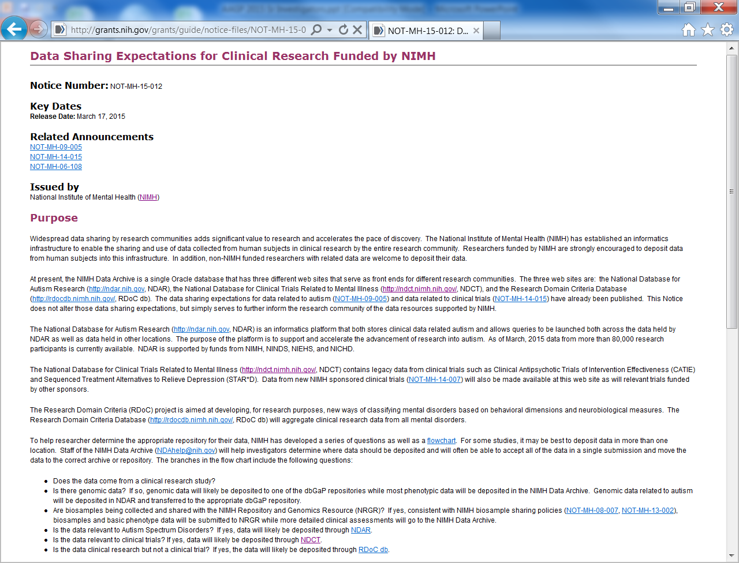

Slide 35
Increased Requirements in Grant Applications
Rigor and Transparency: Must specify how the study will address/enhance research rigor and transparency (NOT-OD-15-103)
Sex as a Biological Variable: Expect to see increasing attention directed toward this

Slide 36
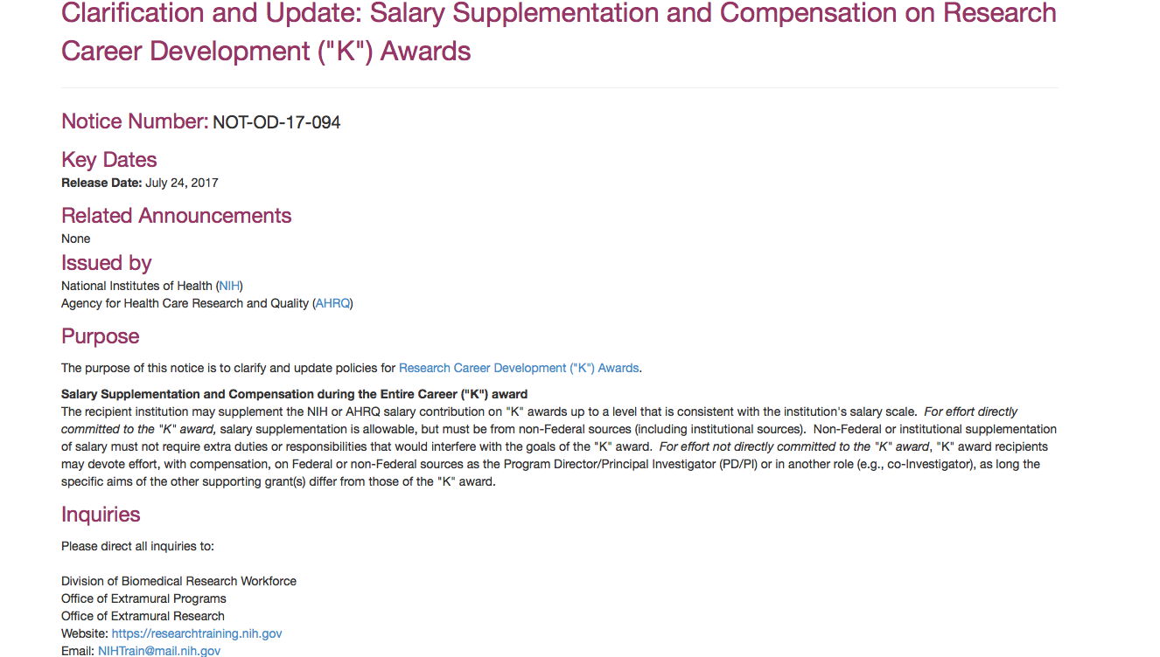
Career Development Award Changes

Slide 37
Questions

Slide 38
Contact Information
Geriatrics and Aging Processes Research Branch; 301-443-1369
Branch Chief; Project Officer for Behavioral Science, and Psychosocial Intervention programs
  George Niederehe, PhD (301-443-9123; gniedere@mail.nih.gov)
Project Officer for Neuroscience, and Pharmacologic & Somatic Intervention programs
  Jovier D. Evans, PhD (301-443-6328; jevans1@mail.nih.gov)

Slide 39
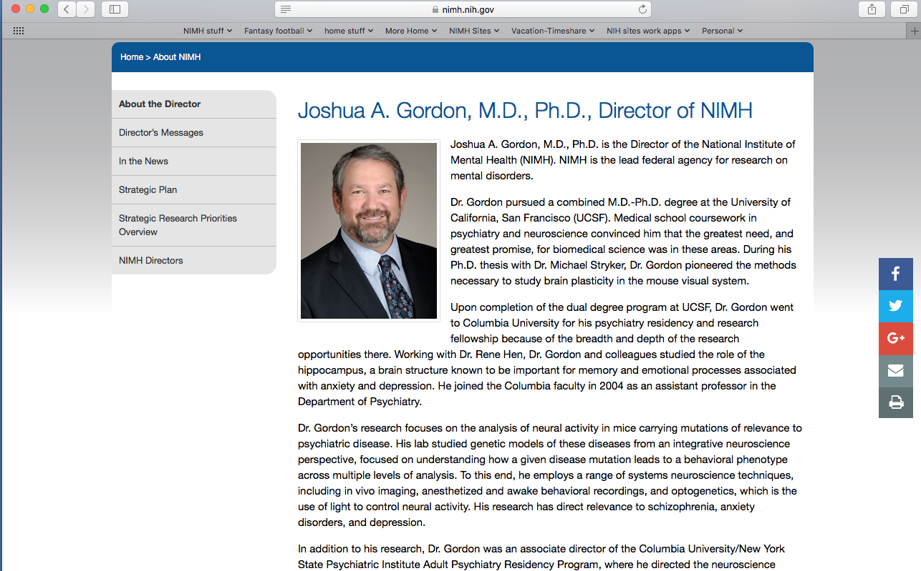

Slide 40

Toward a Balanced Research Portfolio
Diversity in scientific workforce, study participants, subject matter, and timeframes
  Short-term
  Medium-term
  Long-term
Notes:
Each of the initiatives and topics I’ve discussed thus far play a part in what I believe to be a balanced portfolio.
Further, I believe a strong research portfolio is based on diversity in many forms.
Importantly, research must have diversity in terms of time frames. We must invest in research that has the potential to improve clinical care over the short, medium, and long term.
Short-term: We must look to those who are dealing with these disorders in the present, and underwrite research that will help ensure broad access to the most effective currently available treatment.
Medium- and long-term: We must build the knowledge base that will lead to transformative treatments in the future, and fully investigate new treatment targets and methods as they arise.

Slide 41

Scientific Priorities
Short-term Goals: Suicide Prevention
  Identify implementable evidence-based practices and knowledge gaps
Medium-term Goals: Neural Circuits
  Develop technologies to interrogate neural circuits, and ultimately improve the understanding and treatment of mental health disorders
Long-term Goals: Computational Psychiatry
  Develop computational perspectives and approaches to improve the understanding and treatment of mental health disorders

Slide 42
Elements of Excellent Science
Assuming everything works…
Rigor: Will the study be definitive?
Impact: How will the study change the field?
Innovation: How will the study shake things up?
Investigator: What do the people add?
20

Slide 43
Other Elements We Consider
Portfolio balance
  Short/medium/long
  Gap areas/crowded areas
Investigators
  Early-stage – cutting edge
  Middle-stage – productive, at-risk
  Diversity of expertise

Slide 44
Adult Maturational Changes and Dysfunctions in Emotion Regulation
Fiscal Year 2017 RFA initiative
Aim: to stimulate mechanistic research on how age- and sex-related changes in emotion processing over the adult life course interact with and may inform the understanding of affective dysregulation in adult mental disorders
Response to RFA was robust and highly positive.
Maintain active interest in this research area; future collaborative efforts being undertaken.
Notes:
The National Advisory Mental Health Council (NAHMC) has approved the following concept for a potential NIMH initiative, which is posted on the NIMH website at http://www.nimh.nih.gov/about/advisory-boards-and-groups/namhc/namhc-concept-clearances.shtml.

Slide 45

Novel Approaches to Understanding the Mechanisms of the Neuropsychiatric Symptoms in Alzheimer’s and Advancing Therapy Development
NSC Conference Room C/D
8:30AM-5:30PM May 8th
8:30AM-2:00PM May 9th
Please register to attend (in person or via webex):
^{https://NIMHDTR.eventbrite.com}

Slide 46
Primary Features of the New Approach
Experimental medicine approach
Emphasis on mechanisms
Target engagement (biological, functional, clinical)
Emphasis on dosage (vis-à-vis the target, not the outcome)
Make Go – No Go decisions about the target/intervention
Fast-fail; learn something from failed trials
RDoC or similar dimensions as treatment indications

Slide 47
What Is a “Target?”
A measurable variable thought to be an underlying factor/mechanism in the disorder or clinical issue of interest, and that the intervention is hypothesized to act on and change
Thus, you need evidence showing the variable’s implication in the disorder or clinical issue
If the experimental therapeutics research should show that clinical change ensues when the target is manipulated, then one can attribute the intervention’s benefits to this “mechanism of action”
Thus, the target variable is sometimes referred to also as the “hypothesized mechanism of action” of the intervention (but more fundamentally, it should be understood as a potentially modifiable property of, or risk factor for, the disorder)

